Slide 1
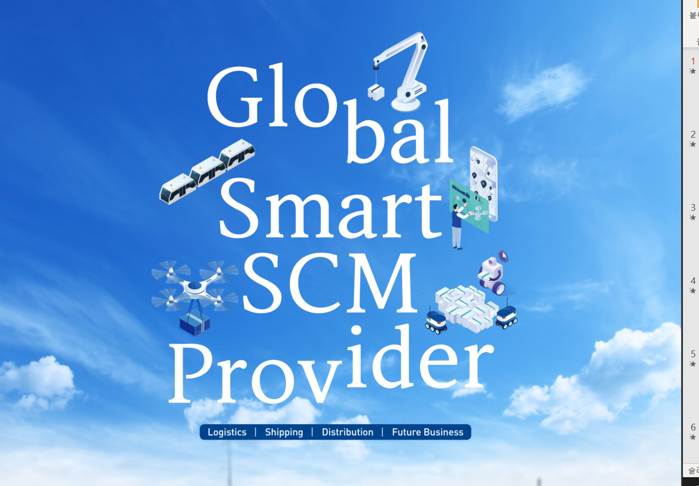

2023

Slide 2

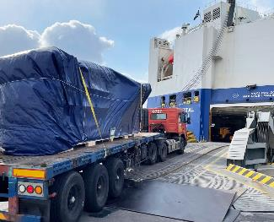
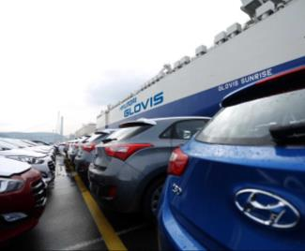
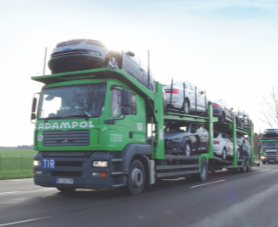
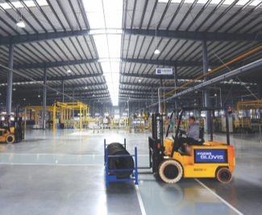
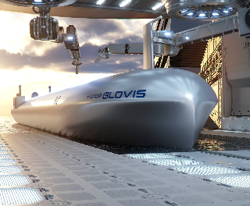

HYUNDAI GLOVIS
“We always creates new value faster than anyone else!”
Increasing the efficiency of the overall customer value chain, HYUNDAI GLOVIS is a comprehensive global logistics company
that is at the top in terms of competitiveness. The company provides flawless logistics services not just in the
field of completed vehicles but also in various other sectors, including the energy, consumer goods and e-commerce sectors.
It also delivers knocked-down parts (KD business) to overseas production plants and runs the relatively new Global Auto-Biz,
through which it seeks to take the used vehicle market to new heights. To prepare for the upcoming future,
we establish an integrated operation system for eco-friendly hydrogen, EV value chain and provide logistics services
using autonomous driving robots. With such efforts, HYUNDAI GLOVIS is trying to become a global top smart logistics company.

Slide 3
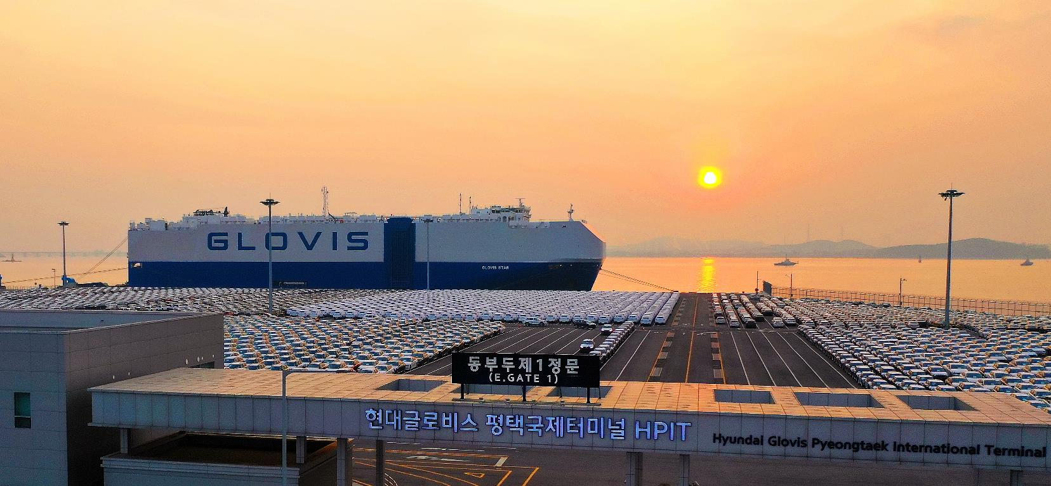
▶ All figures in the data are based on 2022
COMPANY OVERVIEW : COMPANY PROFILE
Global Top-tier Smart SCM Provider!
This is HYUNDAI GLOVIS.
Establishment History
Established on Feb. 22, 2001
Headquarters : 83-21, Wangsimni-ro, Seongdong-gu, Seoul
No. of employees
Domestic: 1,831 / Global: 8,957
Business Areas
Logistics, KD, Shipping, Trading, Used car,
EV∙Hydrogen business∙Logistics Platform
Sales
KRW 27 trillion
No. of locations
Domestic: 49 / Global: 96

Slide 4
COMPANY OVERVIEW : MANAGEMENT RESULT
HYUNDAI GLOVIS’ competitiveness is our customers’ competiveness.
HYUNDAI GLOVIS have enjoyed steady annual growth by securing competitiveness
through nurturing top experts in logistics and distribution and creating a highly advanced IT system.
(Unit: KRW Billion)
Major Financial Performance in 2022
■ Total Assets
■ Sales
■ Operating Profit
10,898.7
12,170.9
13,877.7
16,519.9
21,779.5
26,981.8
662.1
1,126.2
1,798.5
2020
2021
2022
2020
2021
2022
2020
2021
2022

Slide 5

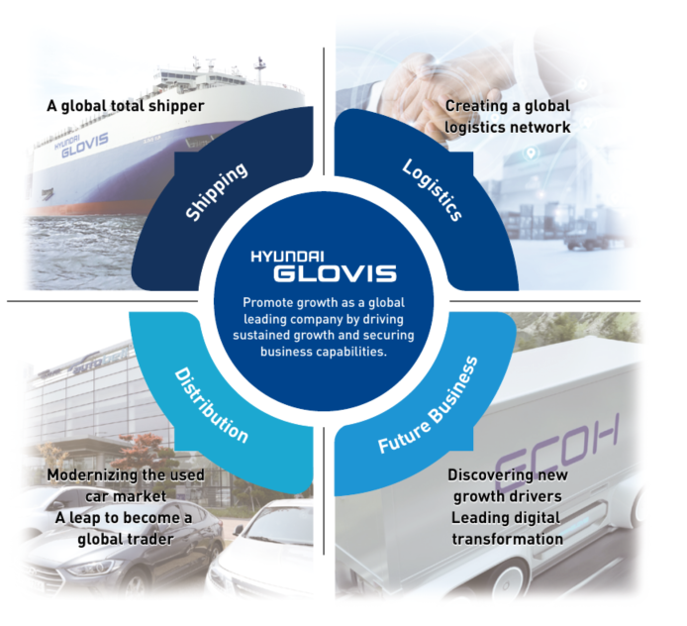
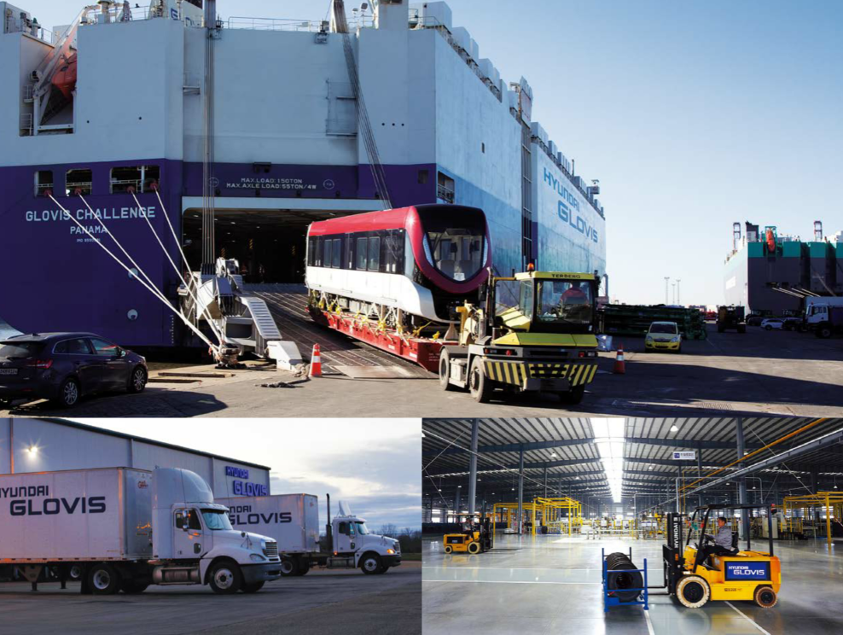
COMPANY OVERVIEW : 비전 소개
By providing differentiated value in logistics & trading services, we pursue sustainable growth by
maximizing efficiency of the customer value chain.

Slide 6
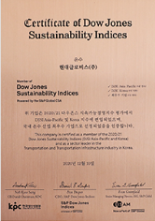
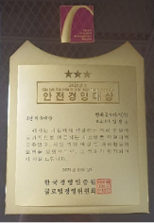
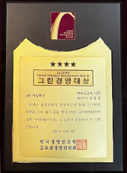
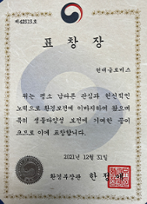


COMPANY OVERVIEW : AWARD & CERTIFICAION
To provide the best value for customers,
HYUNDAI GLOVIS’ challenge and innovation continues.
Major Awards
Awarded "Safety Management Award" by Global Standard Management Awards
Awarded 'Green Management' at the Global Standard Management Awards
Commendation from the Minister of Environment for Biodiversity Conservation
Enlisted to the ‘DJSI World’ First logistics company in Korea.
CDP Carbon Management Honors Club Award
Certified Green-Logistics Company

Slide 7


BUSINESS OVERVIEW : BUSINESS NETWORK
GLOBAL BUSINESS
NETWORK
Europe
Corporations 11
Branches 7
Offices 24
North America
Corporations 8
Offices 8
Asia
98
Corporations 16
Branches 12
Middle East
Branches 1
South America
Corporations 3
Branches 3
Offices 1
Oceania
Corporations 1
96
49
GLOBAL NETWORK
DOMESTIC NETWORK
96
39
Corporations
Head Quaters
4
1
Office
Auction Houses
10
Branches
23
Subsidiary Company
1
Logistics Center
13
Terminal
2
Offices
34
Business Offices
6
Freight Office
12

Slide 8
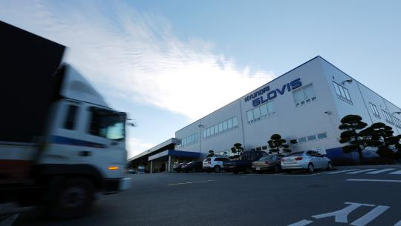
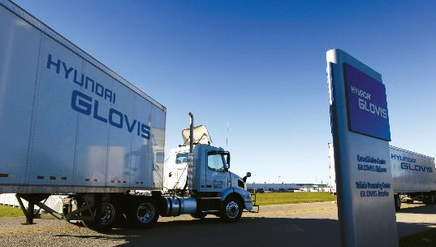
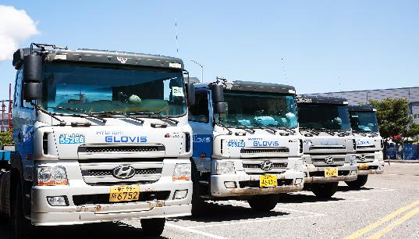


BUSINESS OVERVIEW : LOGISTICS BUSINESS
LOGISTICS BUSINESS
We provide one-stop logistics service using an efficient
network and high-tech systems.
From logistics transportation to storage, handling, and consulting in and out of Korea, the competitive high-tech logistics
system of HYUNDAI GLOVIS and its efficient network of expert personnel provide one-stop service for the logistics industry.
■ Export & import
■ Vehicles
■ Parts
■ Bulk
■ General logistics
■ Special logistics
: Packaging, custom clearance, transportation & storage based on global network & info system
: Transportation of complete vehicles, quality inspection, decoration & harbor loading & unloading
: Supplying parts necessary for production of complete vehicles, including lease of logistics machinery
: Logistics for large volume of heavy weight cargo & conducting projects for overseas basic industries
: Integrated logistics service for customers of various industries such as cars, steel & chemicals
: Supporting logistical innovation & efficiency for special products & military goods
Major performances in volume
Imports & Exports
Marine
564,409
TEU
Aerial
49,795
tons

Slide 9
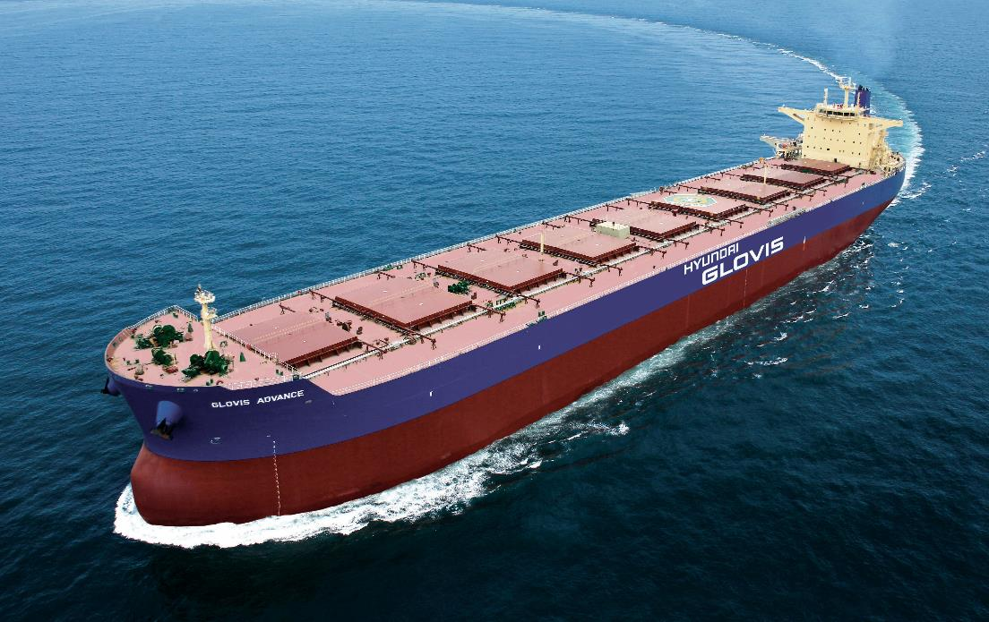
BUSINESS OVERVIEW : Marine Transportation
SHIPPING BUSINESS
As a global shipping company grabbing the world’s attention, we are raising
the international competitiveness of the Korean marine transportation market
Hyundai Glovis satisfies our clients with transportation services covering all range of cargo from transportation
of complete vehicles, used cars, and construction equipment to crude oil, coal, and iron ores.
■ Complete vehicles / Special cargo
Transportation
No. of
Vehicle Carriers: 81
No. of
Bulk Carriers: 35
With our PCTC (Pure Car and Truck Carrier) and cooperation between headquarters and overseas branches, we maximize customer satisfaction and develop various sea routes.
HYUNDAI GLOVIS provides 3PL services for various automobile manufacturers including GM, Volkswagen, Ford, BMW, expanding the service portion of 3PL.
It also transports heavy equipment for construction, buses, and trains through PCTC.
Transportation of
complete vehicles
Bulk Transportation
3.17 Million vehicles
40.45 Million tons
■ Bulk transportation
With extensive experience in shipping all kinds of freight including iron ore, coal and crude oil, we provide optimal logistic service to preemptively deal with customer demands.
No. of Vessels
116

Slide 10


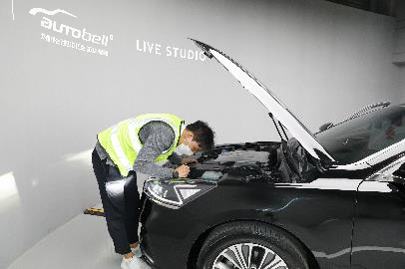
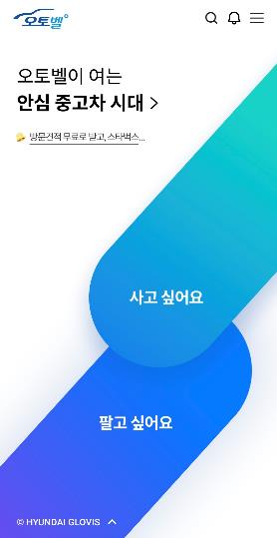
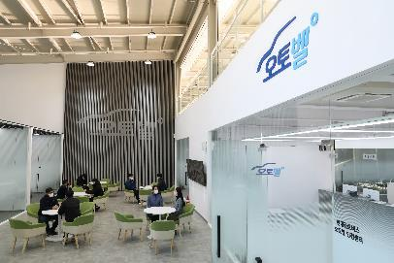

BUSINESS OVERVIEW : Distribution Business
USED CAR BUSINESS
We are increasing transparency and reliability of the used car market.
By operating Korea's largest used-car auction houses and through online used car platform “Autobell”,
we raise the transparency of and public confidence in the Korean market for used car distribution.
■ Autobell : Online used car dealing platform
http//autobell.co.kr
Selling used cars – Provide various sales options (Free Inspection and appraisal by specialist visit, Online open bidding, Evaluation-free Instant Sale)
Purchasing used cars – Reliable vehicles with certified checkpoints at Autobell’s Live Studio Provide Online payment Service, Home delivery service to your door
Free Market Price Information – Provide convenient and practical price information linked with selling/buying cars on the online platform
■ Smart Auction : Used-car Auction Brand
Supporting fair and reasonable sales of customer cars by operating used-car auction
houses in Bundang, Sihwa and Yangsan
Price
Competitiveness
Reliability
Fairness
Convenience
Ensuring high price
selling via open bidding
to 2,200 members
Guaranteeing safe transactions by managing
entire distribution process
Showing entire progress and result online in real time
Providing one-stop
service from vehicle evaluation to agency
and nominal transfer
No. of Cars(accumulated) shown in Auction:
1,510,797
No. of Auction
Members
2,200

Slide 11
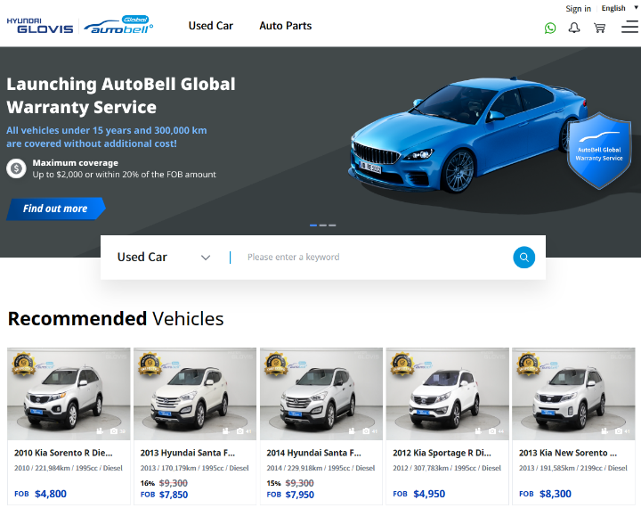
BUSINESS OVERVIEW : Distribution Business
USED CAR BUSINESS
We conduct differentiated used car export business based on global network.
Through our specialized used car export platform and professional services, we are establishing a strong presence in the global used car market by exporting high-quality vehicles to various countries
■ ‘ Global Autobell’, a platform specializing in used car exports
Provide customized services
– Provide country-specific export consultation from used car export experts (English, Arabic, Spanish, Russian, etc.)
- Provide regular shipping services utilizing global logistics network
Ensure superior quality
- Export high-quality used cars to 4 regions (Middle East, Latin America, Africa, and CIS)
– Hyundai Glovis Certification Service completed 101 items inspected by maintenance experts
- Compensation service offered in case of discrepancy with the quality information provided by Hyundai Glovis
• Our Strengths
Reliable Quality
Convenience
Expertise
Competitiveness
Transparent disclosure of vehicle quality and information through inspection of 101 items
Provide one-stop service for customers (vehicle tracking, purchasing, logistics, etc.)
Country-specific export consultation services through specialized call centers
Leverage our own global logistics network
Cumulative number of used car exports
15,272
Number of members
3,000

Slide 12


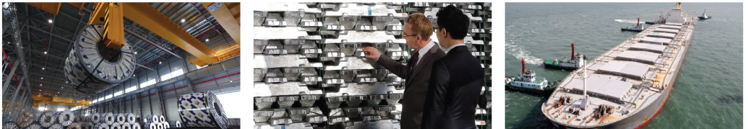
BUSINESS OVERVIEW : Distribution Business
TRADING BUSINESS
With its deep and extensive knowhow in logistics and distribution and
its global network, HYUNDAI GLOVIS creates a new synergy.
Based on unrivaled competitiveness in logistics and distribution,
we promote trading in various fields, generating stable and continuous profit.
■ Trading : Trading of raw materials & finished goods, importing & exporting of nonferrous metal & steel, performing three-way trade
Major Services
What is trading? Business arrangement in which raw materials are purchased at low prices and sold at higher prices by analyzing
supply & demand conditions in domestic and overseas markets and utilizing various terms of trade
We have experienced professionals in trading the non-ferrous metal business (Aluminum and Copper)
We trade wide range of non-ferrous products from raw materials, intermediate materials to finished products providing the logistics services such as storage and transportations.

Slide 13
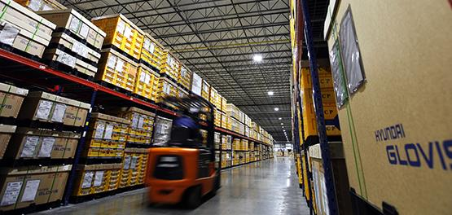
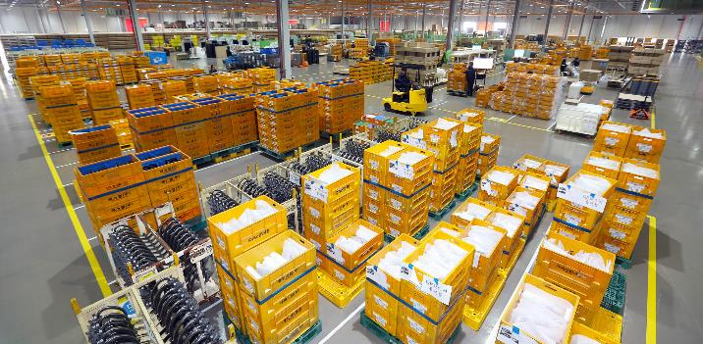
BUSINESS OVERVIEW : Distribution Business
KNOCKDOWN PARTS BUSINESS
Transporting and supplying automotive parts to factories worldwide,
HYUNDAI GLOVIS raises the competitiveness of the Korean automotive industry.
From taking orders for parts to packaging, transportation, inland transportation at site, storage and JIT delivery,
HYUNDAI GLOVIS provides KD distribution service to improve the production of completed vehicles abroad.
■ KD Distribution : Providing integrated distribution service from automotive parts supply,
quality control & customs clearance to transportation
■ KD Packaging : Providing automotive parts packaging service optimized for assembly
& manufacturing at factories for complete vehicles abroad
What is KD? exporting parts instead of finished goods for
assembly & manufacture of overseas factories
Major performances and status
KD Supply
Controlled KD items
65,495 FEU
38,770 Items
No. of Vehicle Types
No. of Overseas Factories
45 Types of
automobiles
14 Factories

Slide 14

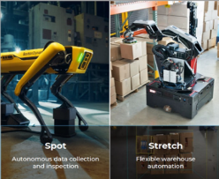
BUSINESS OVERVIEW : Future Business
FUTURE BUSINESS
We discover new growth engines and provide customized solution
based on hydrogen/EV/smart logistics technology.
We operate a top-tier technology research lab to deliver digitally driven, customized solutions and promote them to enable smart logistics.
In addition to EV-related logistics/distribution/platform services, we also provide optimal hydrogen distribution services using the global hydrogen supply chain management platform.
Digital Transformation
Robotics/Automation
FITC
Leading Logistics Digital Transformation
Developing new businesses based on platforms and new technologies
Optimized AI/ML development & decision-making automation
Future Innovation
Tech Center
Providing Smart Logistics Center Design/Building & Operational Solutions
Robotics/Automation Technology R&D
Next Generation IT
Consulting & Process Innovation
Establish/operate logistics IT systems
Gain visibility & provide end-to-end services
Design/propose global network optimization
and operational innovation
Process/system standardization,
optimization, and digitalization
■ Smart Logistics
■ Hydrogen Business
■ End-of-life EV Battery Business
■ Future Innovation R&D
Promote smart logistics-related business by securing smart logistics technology and establishing a transportation platform
Expand distribution/logistics and identify additional business opportunities to construct SCM in the hydrogen energy ecosystem
Identify and develop new business opportunities in the End-of-life EV battery industry
Our global top-notch technology R&D center offers consulting on optimization and customized solutions based on digital technology

Slide 15

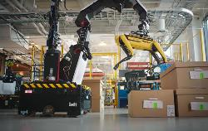
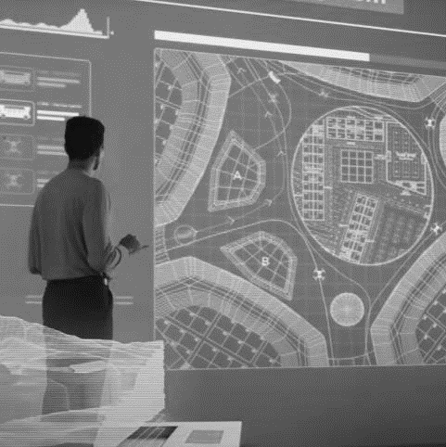
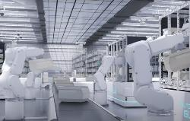

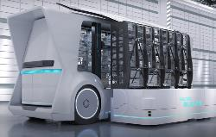
BUSINESS OVERVIEW : Future Business
SMART LOGISTICS SOLUTION BUSINESS
We provide smart logistics solution services that will lead innovation in logistics centers and contribute to establish logistics automation systems
World-class robot technology, abundant automation center operational experience and mobility technology capabilities are reflected throughout the business execution processes, strengthening our customer's logistics competitiveness
1
The Outstanding Robot Technology
Logistics
Consulting
Conceptual Design
Detailed Design
System Construction & Execution
System
Stabilization
Upgrading
System
Possess global capabilities for logistics robot technology
2
The Outstanding Warehouse Operation
Possess the ability to operate automated distribution centers
with the latest technologies
3
The Outstanding Mobility Innovation
Building a hyper-connected SCM ecosystem
that connects mobility and facilities

Slide 16
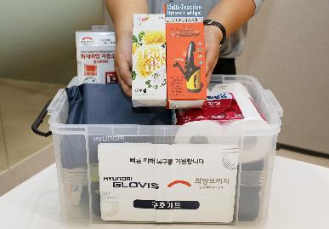
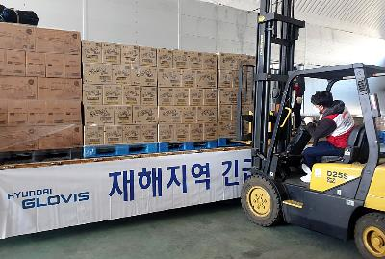

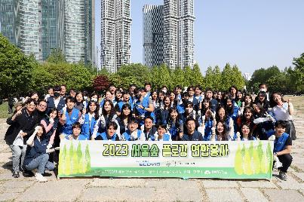

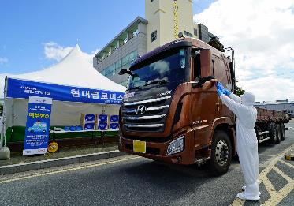
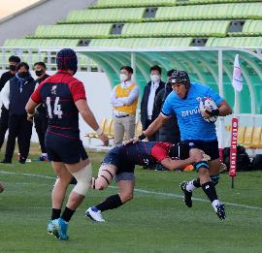
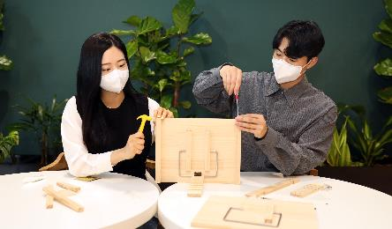





COMPANY OVERVIEW : Social Contribution
Foundation of Korea Logistics Industry
Promotion (KLIP)
Distribution of safety-kit /
Transport of relief goods
Social contribution program,
"Safety Awareness
Campaign”
• HYUNDAI GLOVIS is the first domestic logistics company to finance
the setup & operation of KLIP to support Korean logistics SMEs
and their employees.
• Distribution of ‘Safe-driving kit’ dedicated for prevention of drowsy
driving and ‘Boat-safety kit’ for vessel safety
Disaster Education / Logistics Safety
Awareness Mentoring Program
HYUNDAI GLOVIS Rugby Team
Since 2015 Hyundai Glovis is executing various
social contribution programs such as
'We Deliver H.O.P. E', Safety Campaign
under the safety-first corporate management
policy.
• Supporting rugby, not so popular sports in Korea, and running
a rugby team for the sport’s long-term development
• Acknowledgement of appropriate disaster response through
extensive programs at HYUNDAI GLOVIS earthquake and tsunami
experience center
• Industrial safety OJT for logistics-specialized high school students
Community Charity Activities
Transportation of relief supplies
to disaster areas
• Delivering lunch boxes (Lunchbox of Love), cleaning environment
and donating goods by forming support relationships with
community welfare centers
• Free carriage of relief goods for refugees in case of disasters

Slide 17
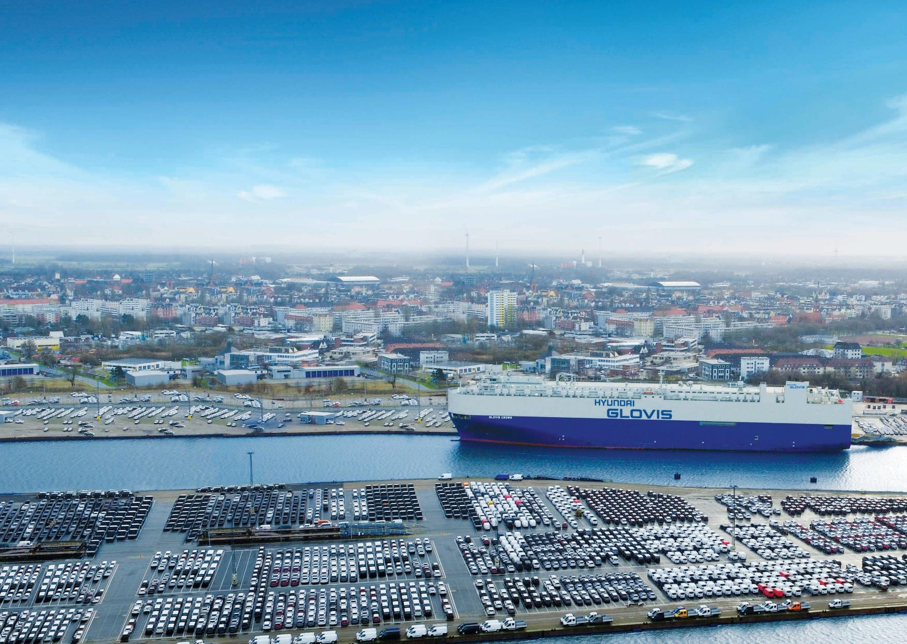
GLOBAL SMART SCM PROVIDER
HYUNDAI GLOVIS constantly pursues challenge and innovation.
We pay our strenuous efforts to achieve customer satisfaction and new growth.

